Slide 1
CRYPTOCURRENCY PLATFORM FOR SOVEREIGN CLIENT
Group Members:
Thoa Le, Altin Marku, Xavier Ruiz

Slide 2

Outline
Project Task
Our Process
Explanation of Each Cryptocurrency Platform
Our Choice of Platform (Summary)
Notes:
This is the brief outline of our presentation today. We’ll cover the project task that involves selecting the most appropriate cryptocurrency platform, our process in deciding which option is best, an overview of each platform based on pros and cons, and lastly, a summary of our choice of platform.

Slide 3
Project Task
Your team is involved in designing a new cryptocurrency for a sovereign client. You have been asked to evaluate various crypto platforms for the basis of your currency.
As a substitute fiat currency, the government is mindful of certain processes and regulations that should be supported and continue to operate flawlessly with the new crypto currency regime as well. These include Anti-Money Laundering (AML), know your customer (KYC), and fraud detection.
What does your team think and would suggest as your team’s platform of choice to your client?
Notes:
Here is the prompt that we were given for our project.

Slide 4
Process and Considerations
Step 1: Stakeholder Requirements
Anti-money laundering (AML)
Know your customer (KYC)
Fraud detection
Step 2: Research Different Platforms
Binance
Coinbase
KuCoin
BitCoin
Ethereum
Step 3: Choose Specific Platform
Notes:
In order to ensure the best platform is chosen, we needed to lay out the stakeholder requirements. The stakeholder in our project task is our sovereign client. They requested that the platform is up to industry standards. Some of the requirements include Anti-money laundering, Know your customer, and fraud detection implementation.
It’s critical to have a platform w/ built-in anti-money laundering tools as it prevents illegal use of the new cryptocurrency for criminal activities involving finances.
The know your customer tool is for the verification of customers. This will help prevent issues such as identity theft and illegal transactions.
The last requirement, Fraud Detection, is critical to detect and prevent fraudulent activities.
Once we are aware of the client’s requirements, it’s important to research various platforms that will meet the said requirements.
The last step to to choose a specific platform that we feel is best suited for our client’s needs.

Slide 5
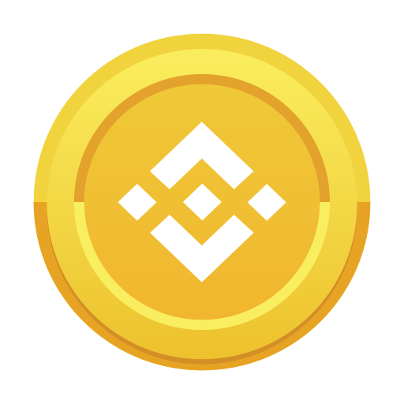
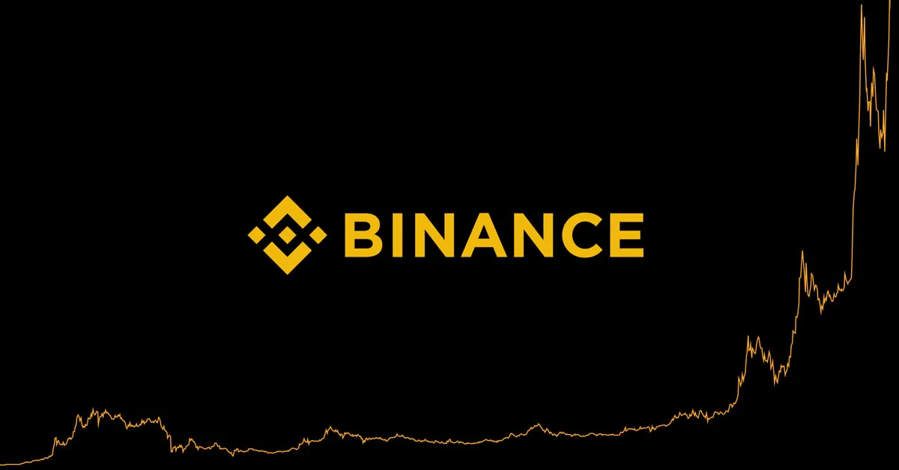
Binance
Pros
Cons
Huge user base
Able to use Binance coin to trade
Outside US jurisdiction
Binance wants a portion of the market tokens for liquidity

Slide 6
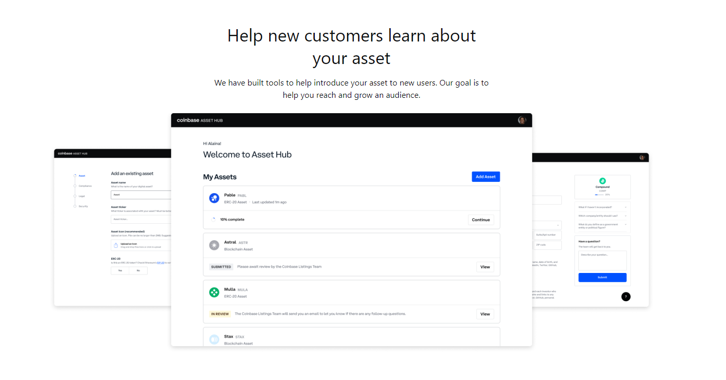
Coinbase
Pros
Cons
Compliance
ERC-20 compatible
Easy to set up
KYC, AML, Fraud Detection
Large userbase w/ over 100m+ users
Hidden fees
Has to hold assets for liquidity

Slide 7
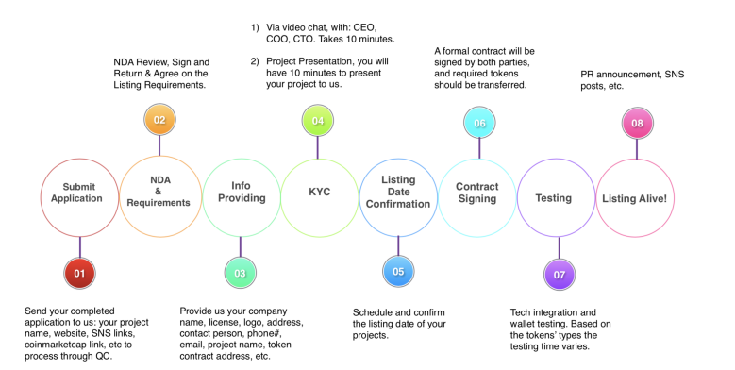
KuCoin
Pros
Cons
Straightforward process
Implements Know Your Customer (KYC) procedure
Diverse market
Requires a stablecoin before purchase
Untrustworthy

Slide 8


Bitcoin Ethereum
Pros
Pros
Secure
Secure
Fast
Massive growth potential
Easily deployable smart contracts
Cons
Cons
Expensive
Slow
Limited growth potential
Price instability

Slide 9
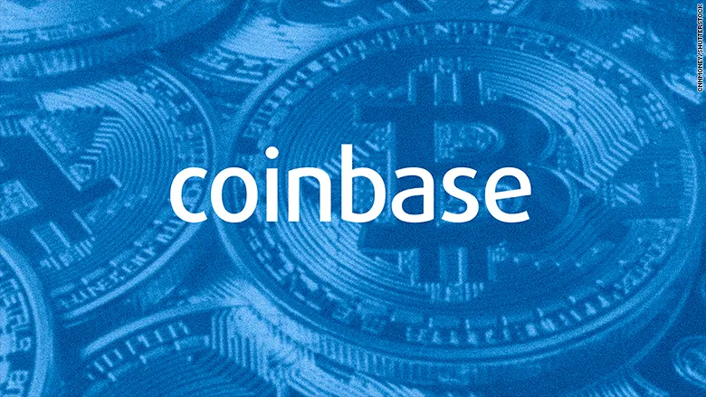

Summary
Coinbase
Compliance
ERC-20 verification
KYC, AML, Fraud Detection
US company
Ethereum
Easy to use Tokens
Smart Contracts
Speedy
Growth

Slide 10
Sources
https://n26.com/en-eu/blog/types-of-cryptocurrency
https://www.investopedia.com/binance-vs-coinbase-5120852
https://blog.chainalysis.com/reports/what-is-aml-and-kyc-for-crypto
https://medium.com/@thusharaj/create-your-own-cryptocurrency-in-ethereum-blockchain-40865db8a29f

Slide 11
Thank you!
Any questions?
Notes:
Thank you for your time and attention!
At this time, we invite any questions or comments you may have.

